Slide 1

What Data is in WRDS?

Slide 2
Learning Objectives
Learn about the different types of datasets available on WRDS
Recognize some of the key datasets used in financial research

Slide 3
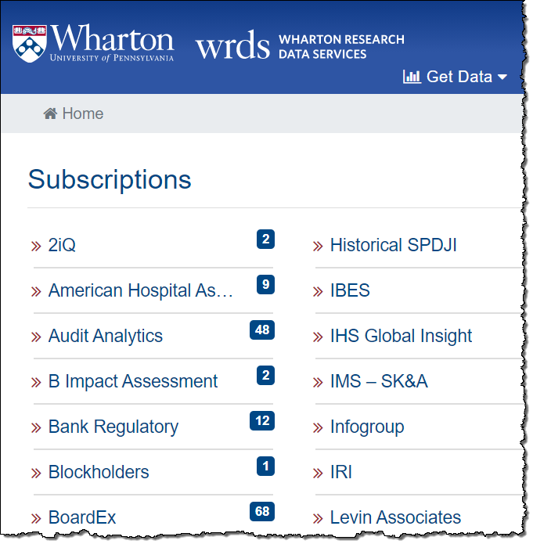
WRDS Data
WRDS is a subscription service; institutions subscribe to different datasets.
All your subscribed datasets are visible from the Home page when you log in to WRDS.

Slide 4
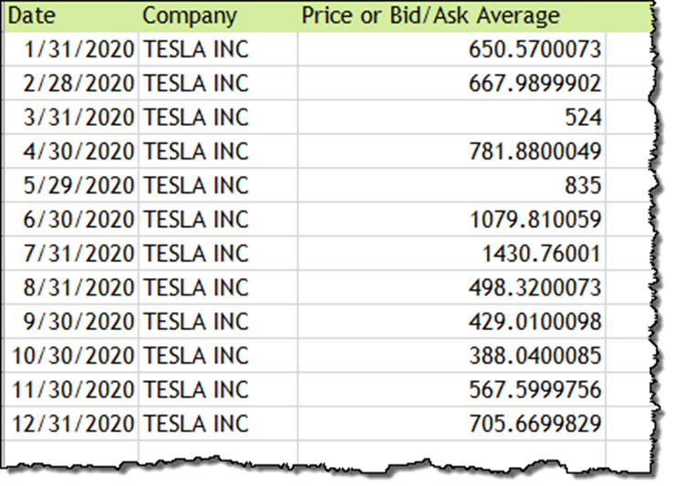
WRDS Financial Data
WRDS is best known for financial data. For example, company fundamentals from Compustat:
Or stock prices from CRSP:

Slide 5
Some Categories of Financial Data
Financial Data
Pricing and Returns
Fundamentals
Earnings and Estimates
Institutional Ownership
Other Types of Data

Slide 6
Pricing and Returns Data
Market pricing and returns data include information about the valuation of assets (e.g., stock, bond, and option prices).
Data also includes information about the transactions of these assets (e.g., the trading volume of a stock).

Slide 7
Pricing and Returns: Dataset Examples
Examples of datasets at WRDS that provide pricing and returns data:
CRSP
Datastream
Compustat Global
TAQ (High Frequency Trading Data)
Markit Security Finance
FactSet
OptionMetrics
TRACE
Mergent FISD

Slide 8
Fundamentals Data
Company fundamentals includes information extracted from the firm’s financial statements. It can also refer to public information about corporate events.
Some examples of “fundamentals” include assets, revenues, earnings, return on equity, and profit margins. This data is used to determine a firm's underlying value and potential for growth.

Slide 9
Fundamentals: Dataset Examples
Examples of datasets at WRDS that provide company fundamentals:
Compustat
FactSet
Capital IQ - Key Developments
RavenPack
Thomson/Refinitiv
Worldscope
Bureau van Dijk
Financial Ratio Suite by WRDS

Slide 10
Earnings and Estimates Data
Earnings and estimates data includes analyst forecasts of company earnings. Actual earnings data may also be available.

Slide 11
Earnings and Estimates: Dataset Examples
Examples of datasets at WRDS that provide earnings and estimates information:
Thomson-Reuters I/B/E/S
Zacks Investment Research

Slide 12
Institutional Ownership Data
Institutional ownership data reflects the amount of a company's stock owned by mutual funds, pension funds, insurance companies, investment firms, private foundations, endowments, or other large entities.

Slide 13
Institutional Ownership: Dataset Examples
Examples of datasets on WRDS that provide institutional ownership information:
Thomson/Refinitiv
FactSet
CRSP Mutual Funds
WRDS 13-F SEC Data
WRDS SEC Insider
Lipper Hedge Fund
AuditAnalytics
Prequin

Slide 14
Other Types of Financial Data
There is a wide range of financial data available on WRDS, including:
Company management and executive compensation (ExecuComp)
Board of directors membership (BoardEx)
Environmental, Social, and Governance (ESG) investing information (Sustainalytics)

Slide 15
Other Kinds of Data on WRDS
In addition to finance, WRDS hosts data from a variety of other disciplines including:
Economics
Banking
Healthcare
Insurance
Management
Marketing

Slide 16
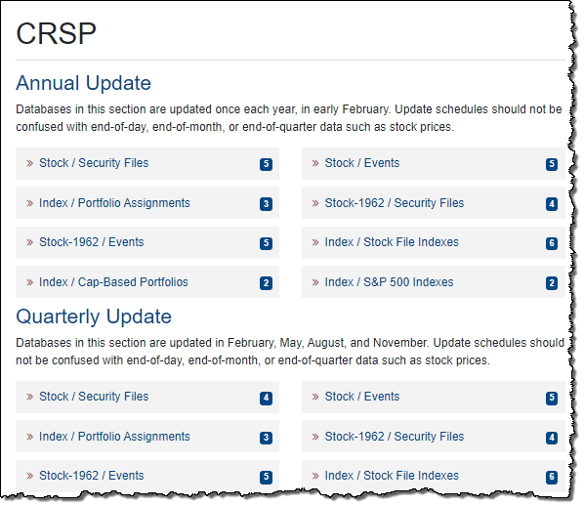
How is Data Organized on WRDS
Data is organized by data vendor, and then within each vendor by type of data.
For example, this page displays the vendor CRSP’s data.

Slide 17
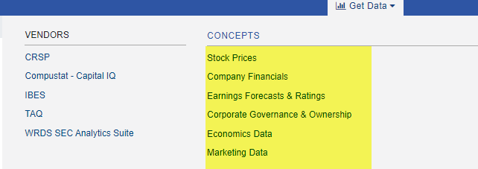
Data by Concept
If you do not know the name of the vendor—but you know what type of data you are looking for—you can also browse WRDS data by concept using the Get Data tab at the top of the screen.

Slide 18
Additional Help
For any questions, you contact WRDS at:
https://wrds-www.wharton.upenn.edu/contact-support/

